Slide 1


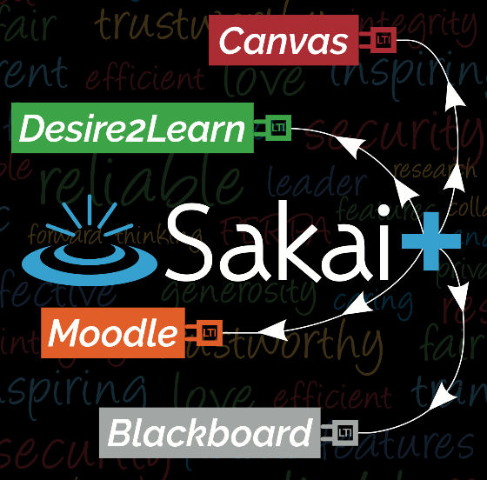
Introducing SakaiPlus
Dr. Charles Severance Sakai PMC Chair
Dr. Wilma Hodges Sakai Community Manager
plus@sakailms.org

Slide 2

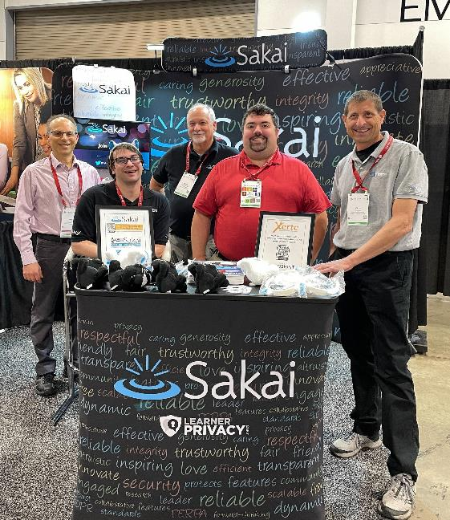
AGENDA
Brief History of LMS/LTI
Current Trends
Sakai Plus Overview and Demo
Benefits of Sakai
Q&A

Slide 3
LMS's Over Time
The Beginning
LTI
Post-Covid; Emerging Tech; AI
LMS Early Days
Post LTI Generation
1997
2010
Present
Lots of startups / innovation / competition
Self Hosted
Purchase / Consolidation
Faculty / Instructional design are the primary audience
LMS is one of the most visible core campus services
LMS Innovation slows – stability is the new focus
LTI Tools – lots of startups / innovation / competition
IT Leadership are the primary audience

Slide 4
LTI Over Time
Initial LTI Specification Established
LTI 1.3 / Advantage Extends Capabilities
LTI 1.1
LTI 1.3
2011
2019
Model – LTI tool is a single learning activity with zero or one grades
May not even need the student's name or email
Just one of many items in course content
The LMS does all the sequencing
LTI tool can have the entire roster and make as many gradebook columns as it likes
Publisher content – One launch and the tool does content sequencing
Course content authored, sequences and experienced in the tool

Slide 5



The Trends We See…
LMS Innovation is slowing.
LMS Satisfaction is "meh" – no system makes everyone happy.
Switching to a new LMS is a lot of work and then … "meh."
The LMS is becoming a learning portal with a basic, unexciting, content sequencing experience.
Faculty and Instructional Designers are finding LTI tools that let them create meaningful content and engage students.

Slide 6


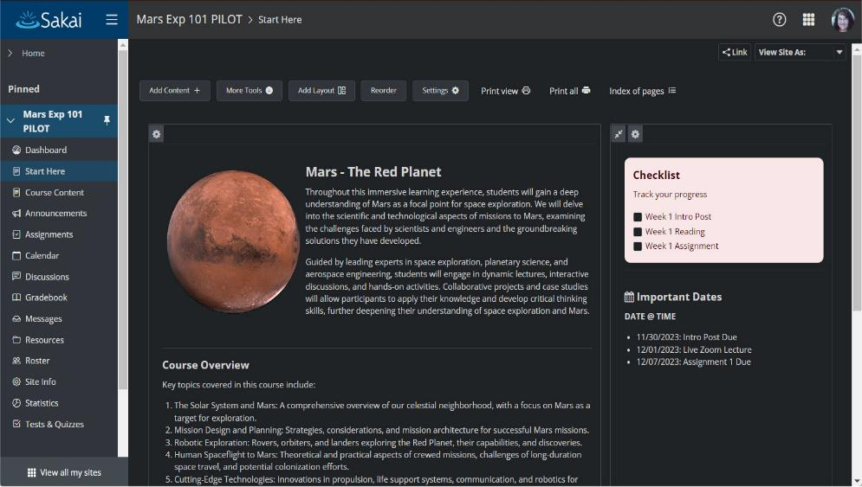
Looking at Sakai LMS...
Campus IT has been told Sakai as a Campus-wide service is "more work than a commercial SASS offering“ but that isn’t necessarily true.
Faculty and instructional designers love Sakai.
Sakai continues to innovate.
We want to build on Sakai’s strengths and not try to get between the IT organization and its "SASS LMS / Learning Portal."

Slide 7

Innovative learning experiences are happening outside the LMS using LTI 1.3…

Slide 8

Innovative learning experiences are happening outside the LMS using LTI 1.3… Make all of Sakai an LTI 1.3 tool!

Slide 9

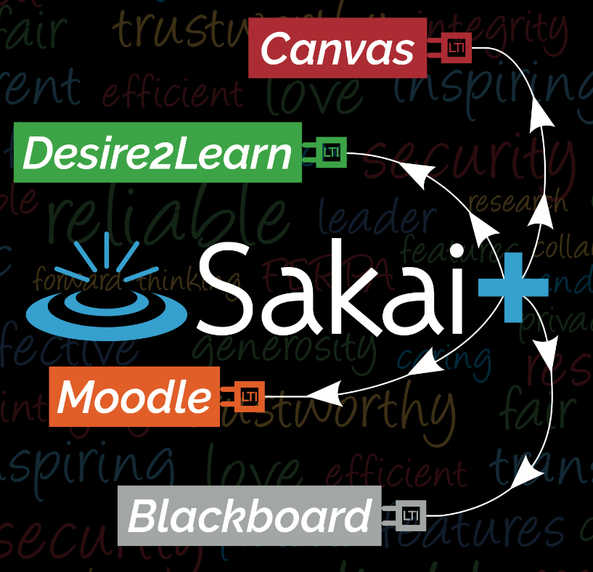

Slide 10

SakaiPlus – LMS Multiverse
Part of Sakai 23
Sakai can plug into any LMS using LTI Advantage (1.3)
Retrieves and synchronizes roster data
Synchronizes all grade book activity
Launch / grades / notifications from campus LMS
Author and teach courses in Sakai

Slide 11
Some Things Are Simpler
Sakai only serves a small fraction of the campus population
Performance tuning is simpler.
Upgrades are simpler.
Hosting is simpler.
Costs are lower.
The heavy lifting is done by the Campus LMS.

Slide 12
Benefits
Your faculty or instructional designers have an option if they don't love the campus LMS.
You can make a "gold standard" course and use it in any LMS.
Your faculty and IDs can be part of an active and engaged community.
Participation
Support
Innovation

Slide 13
Live Demo of Sakai Plus in Canvas
Dr. Charles Severance Sakai PMC Chair

Slide 14
Sakai Tools
Dr. Wilma Hodges Sakai Community Manager

Slide 15




A Few Tools People Often Request
PostEm
Roster
Tests & Quizzes
Lessons
CSV upload to share feedback with students
Nicknames, Pronouns, Name Pronunciation, “Name that Face” Game for faculty
Extremely feature rich, robust testing engine
Flexible content authoring

Slide 16
PostEm
CSV upload to share feedback with students

Slide 17

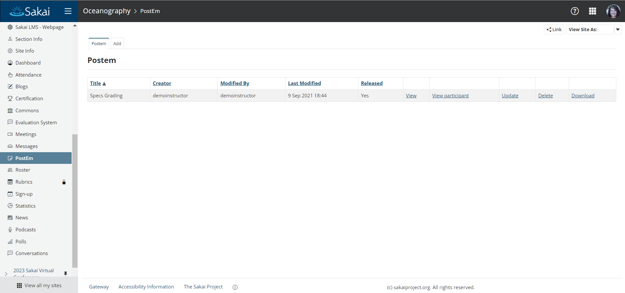
PostEm Tool

Slide 18
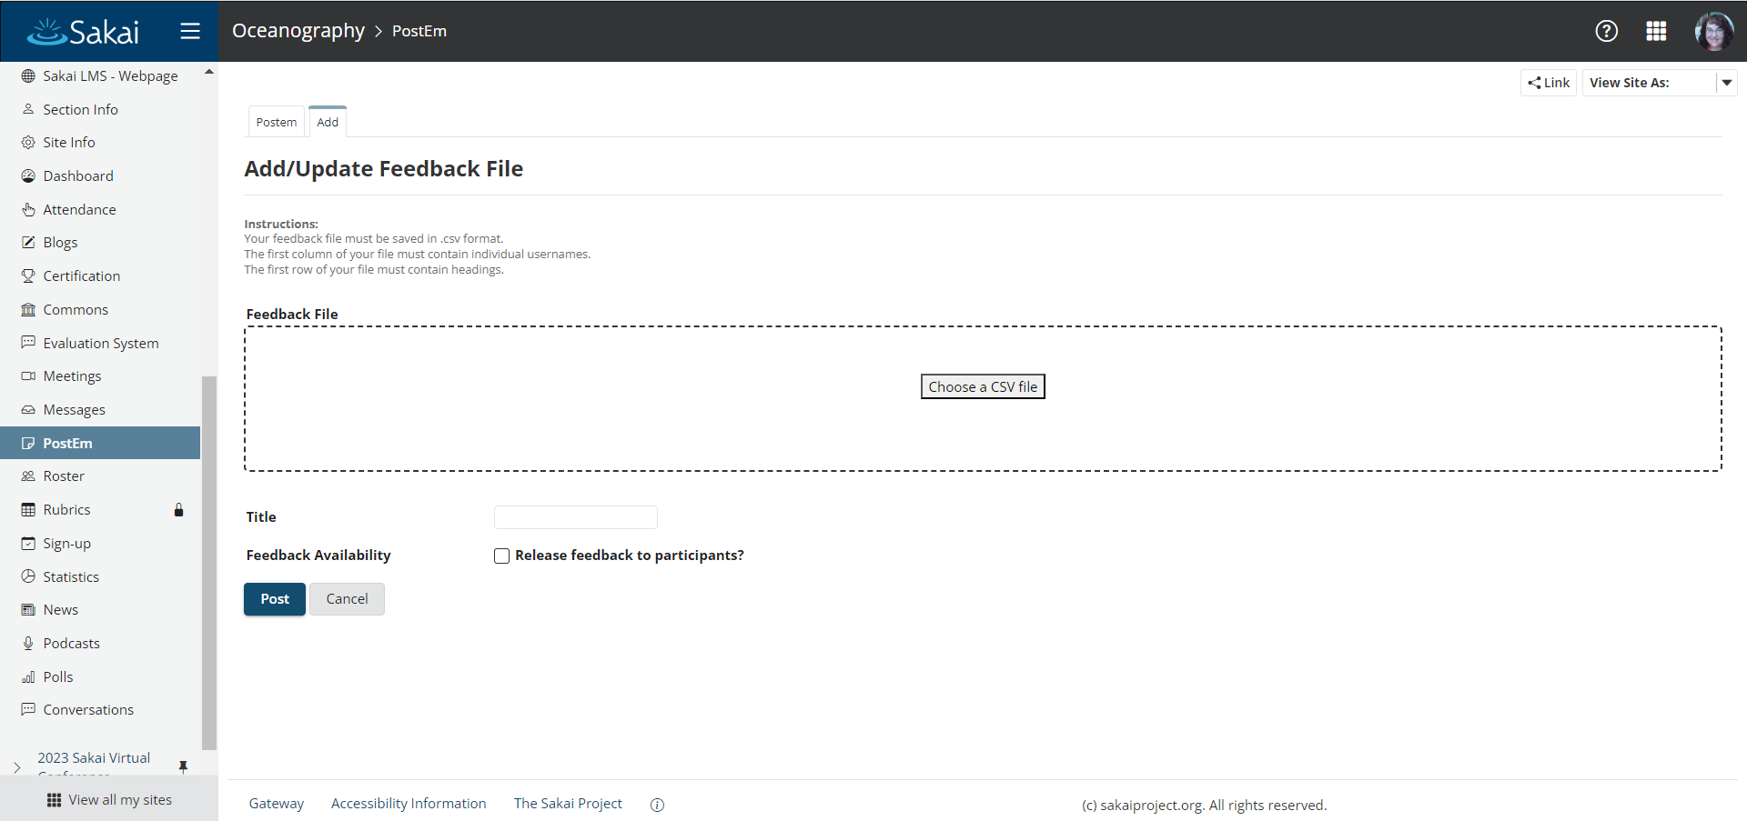
PostEm Tool

Slide 19
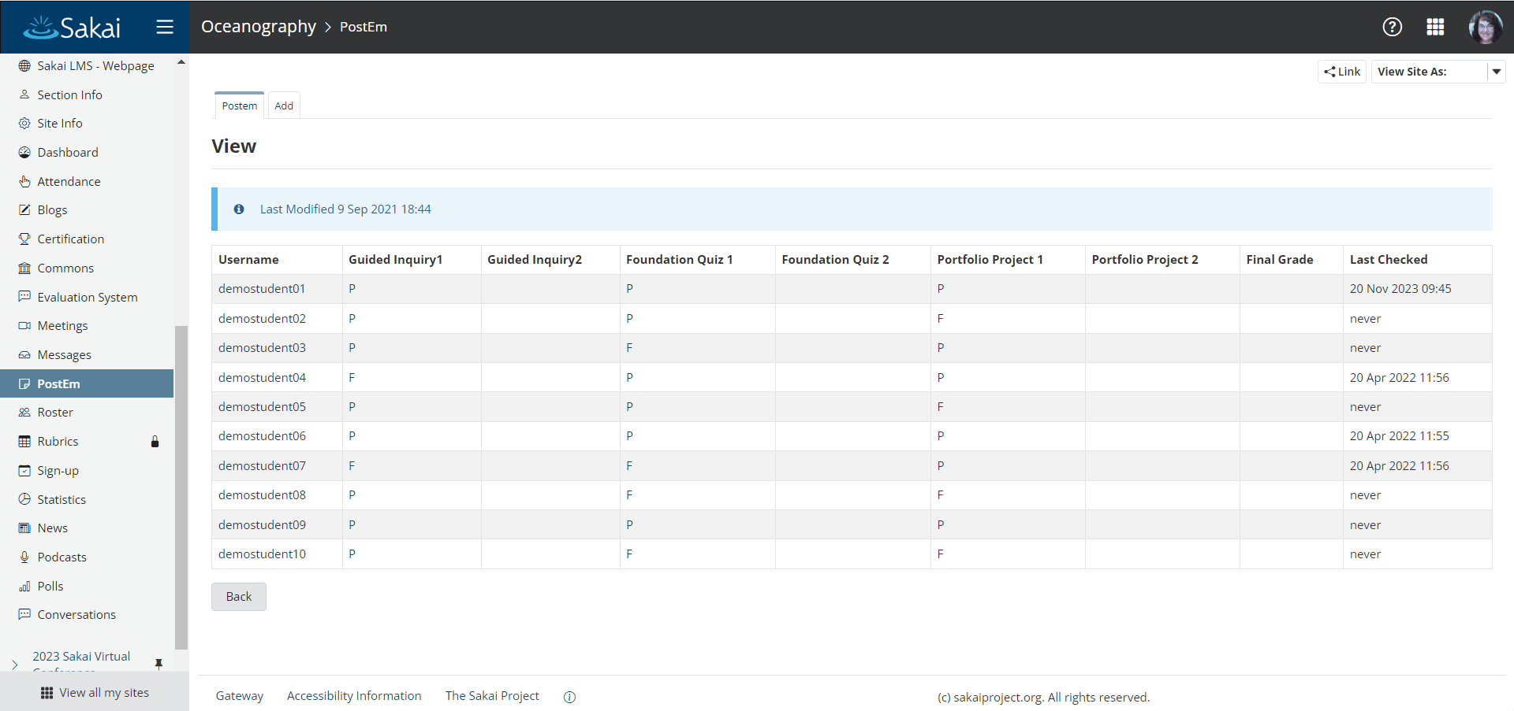
PostEm Tool

Slide 20
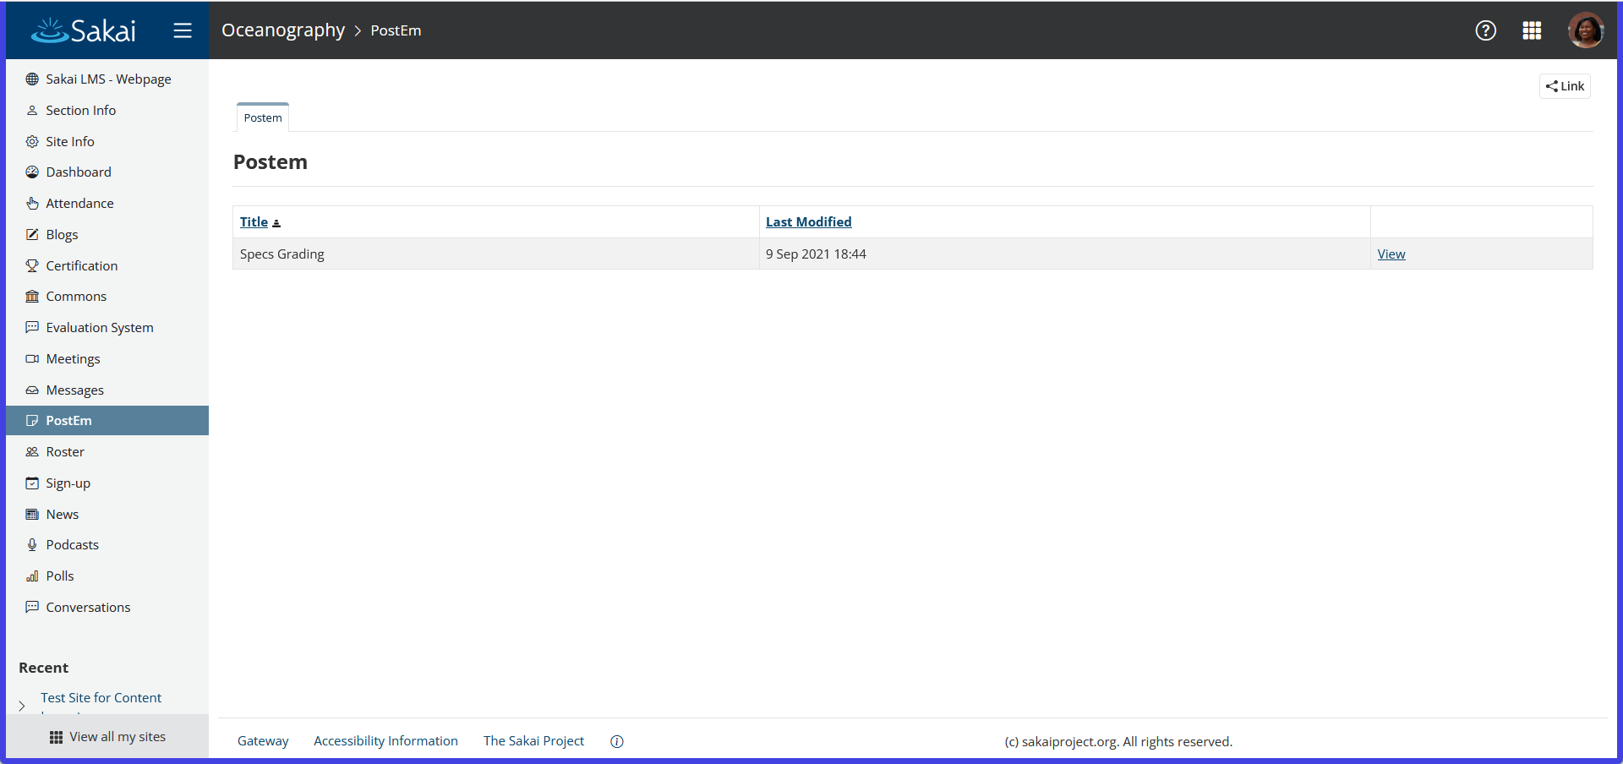
PostEm Tool - Student View

Slide 21
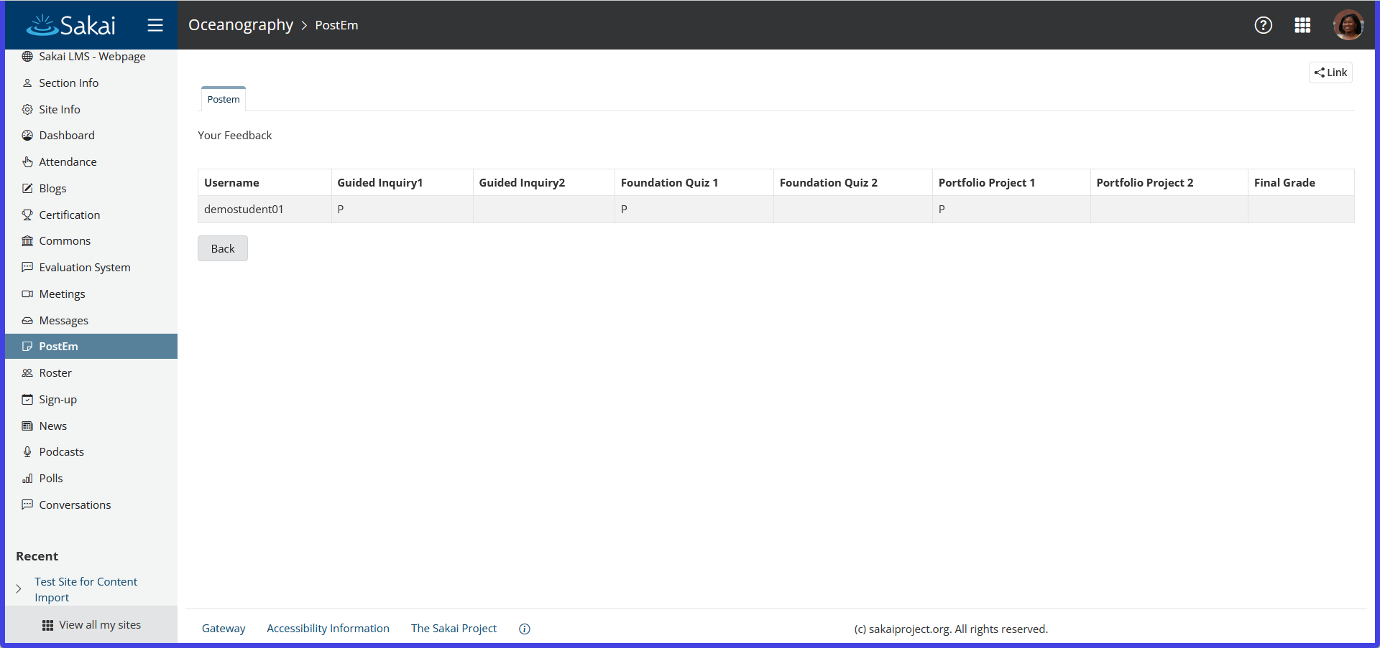
PostEm Tool - Student View

Slide 22
Roster
Nicknames, Pronouns, Name Pronunciation, “Name That Face” Game for Faculty

Slide 23
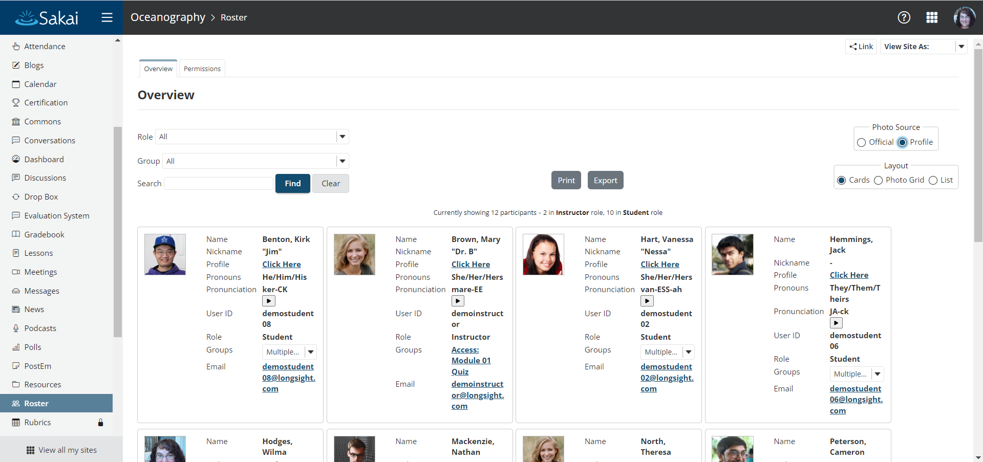
Roster - Card Layout

Slide 24
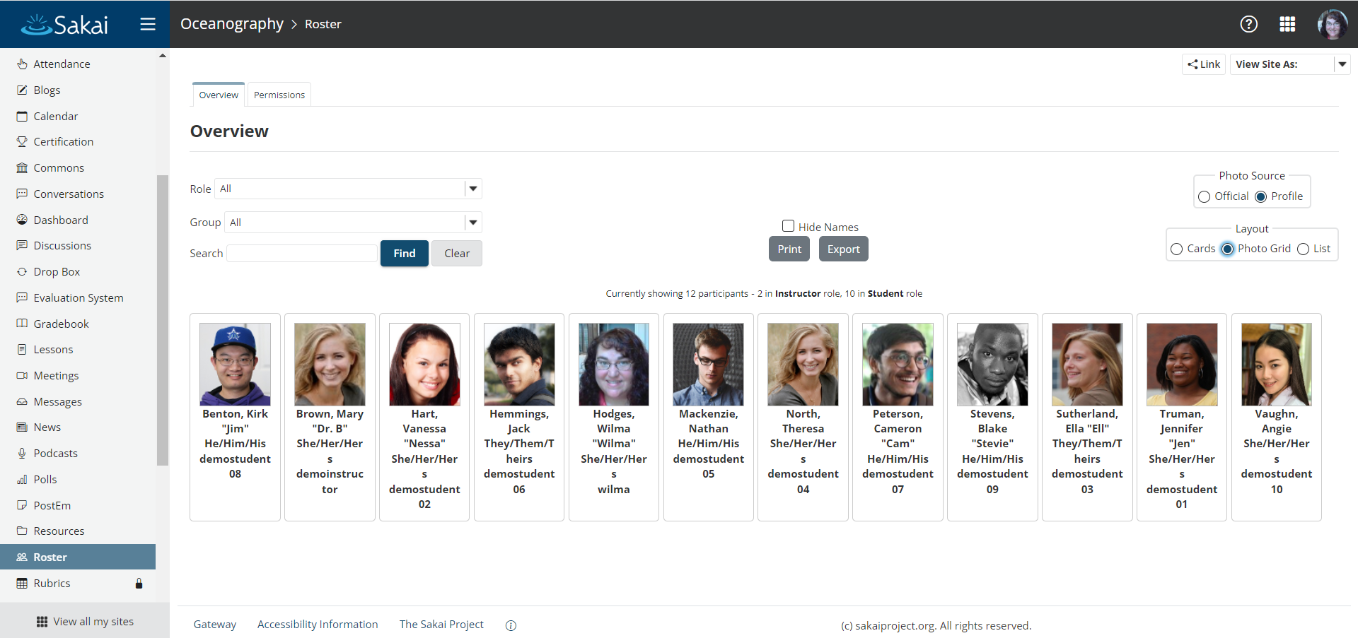
Roster - Photo Grid Layout

Slide 25
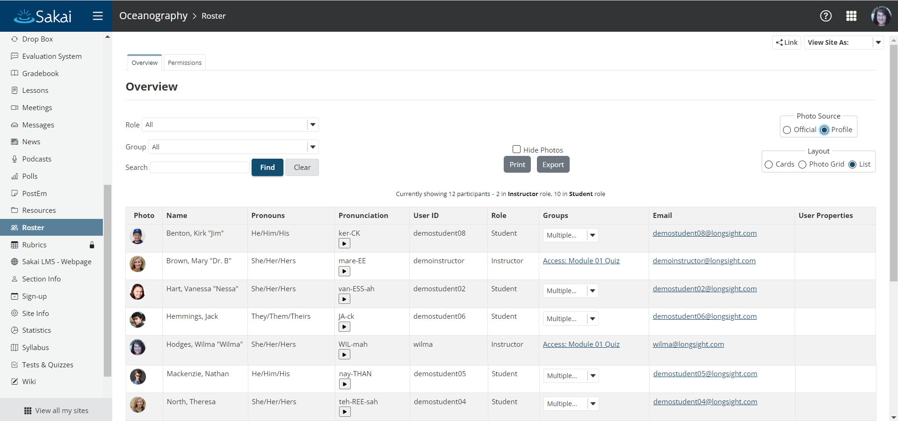
Roster - List Layout

Slide 26
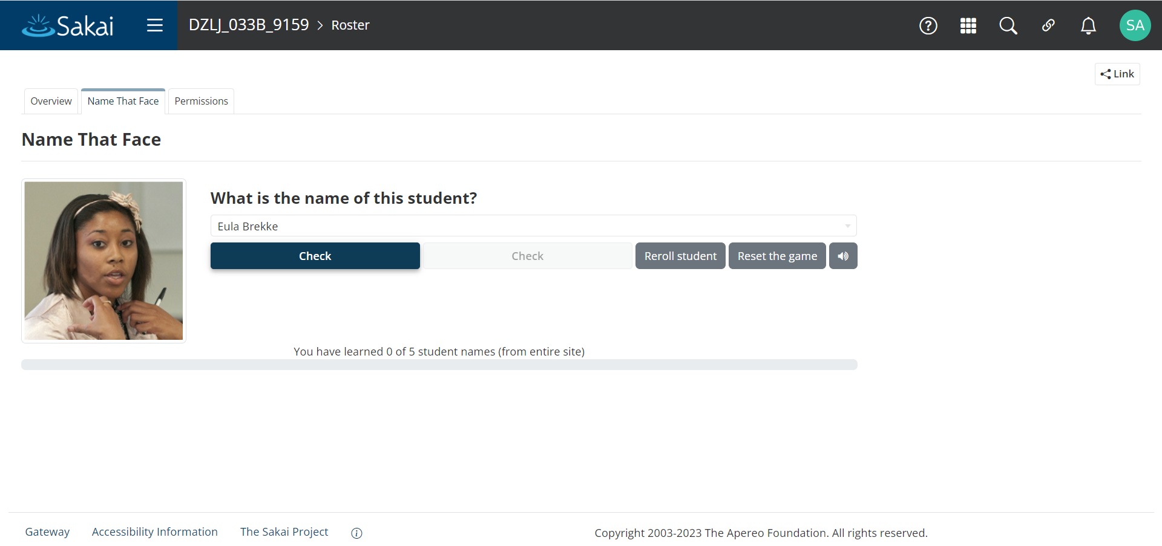
Roster - “Name That Face” Game (coming in Sakai 24)

Slide 27
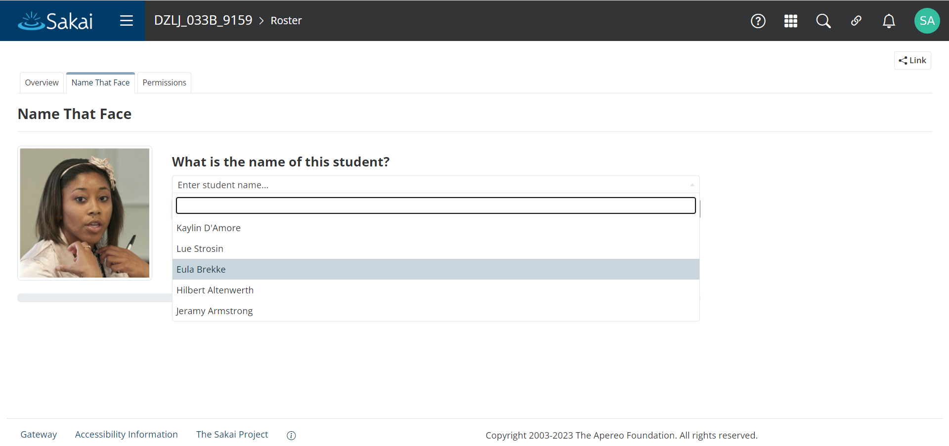
Roster - “Name That Face” Game (coming in Sakai 24)

Slide 28
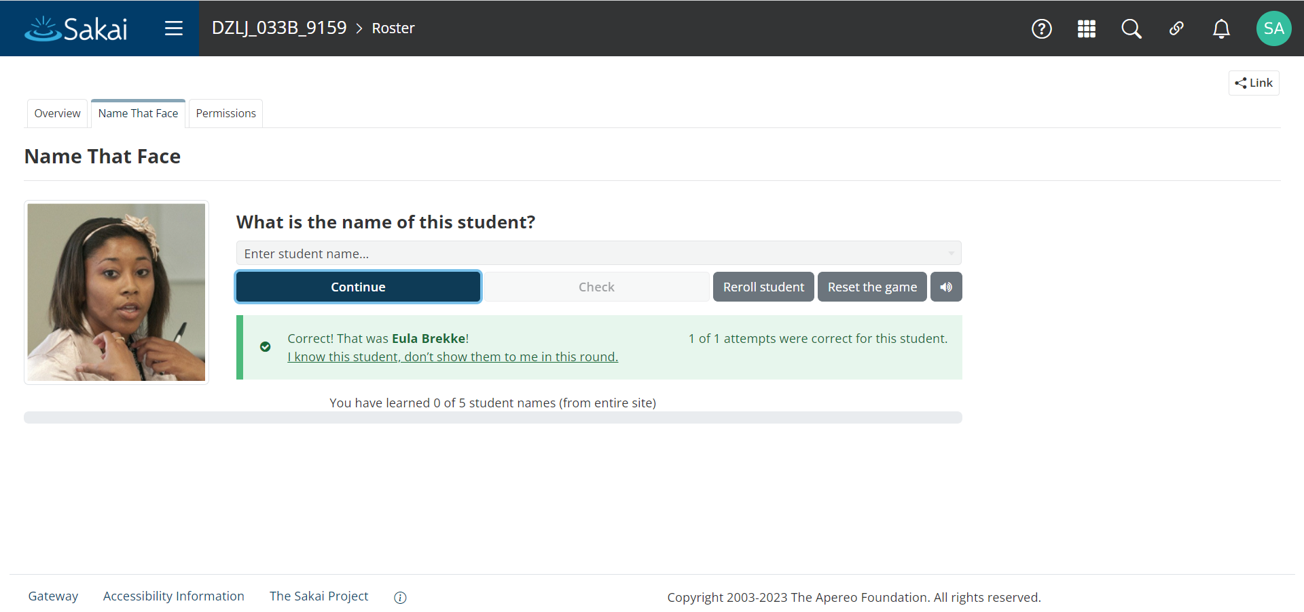
Roster - “Name That Face” Game (coming in Sakai 24)

Slide 29
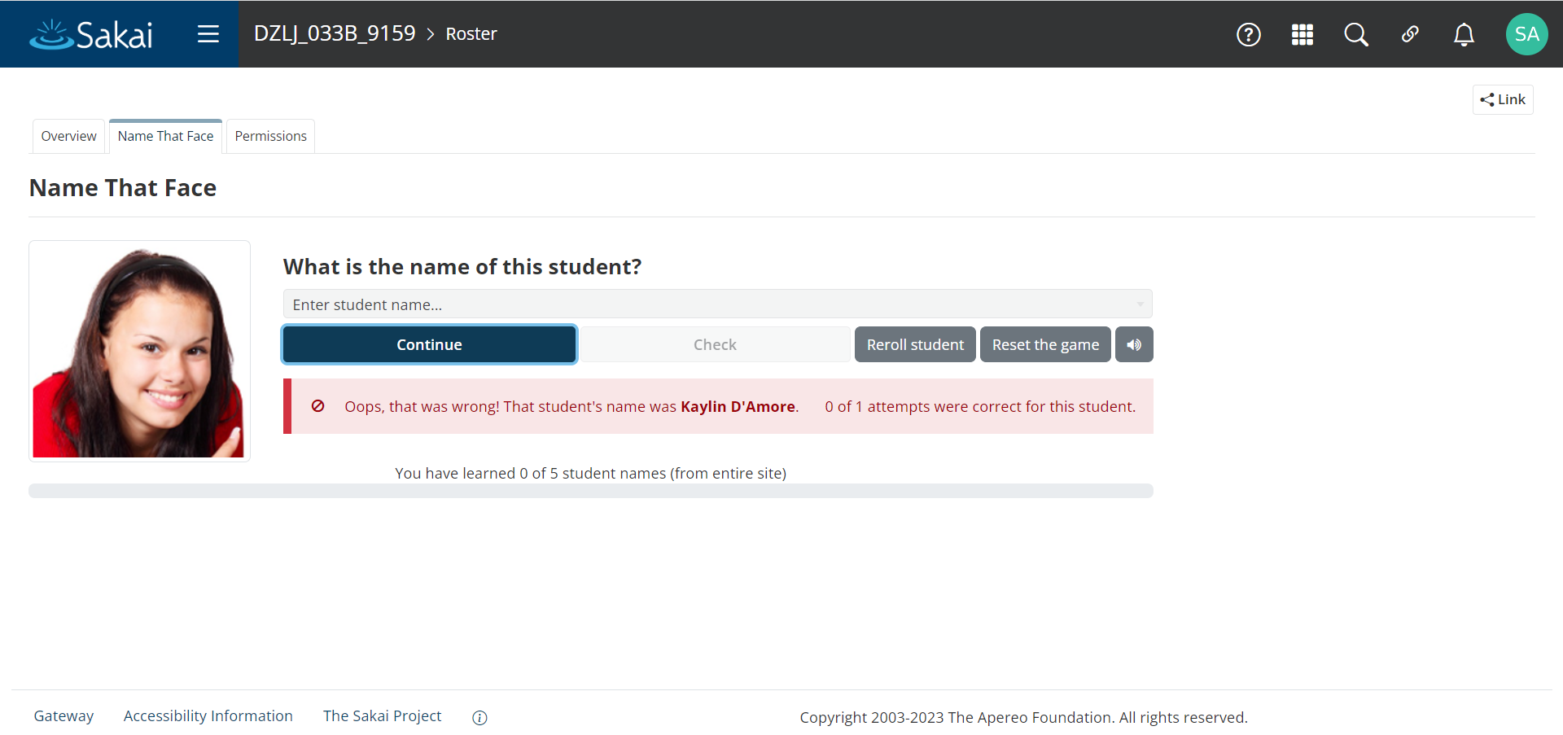
Roster - “Name That Face” Game (coming in Sakai 24)

Slide 30
Tests & Quizzes
Extremely Feature Rich, Robust Testing Engine

Slide 31
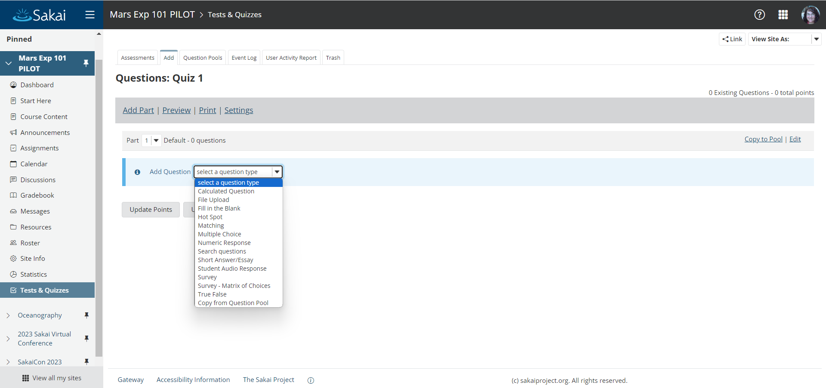
Tests & Quizzes - Question Types

Slide 32
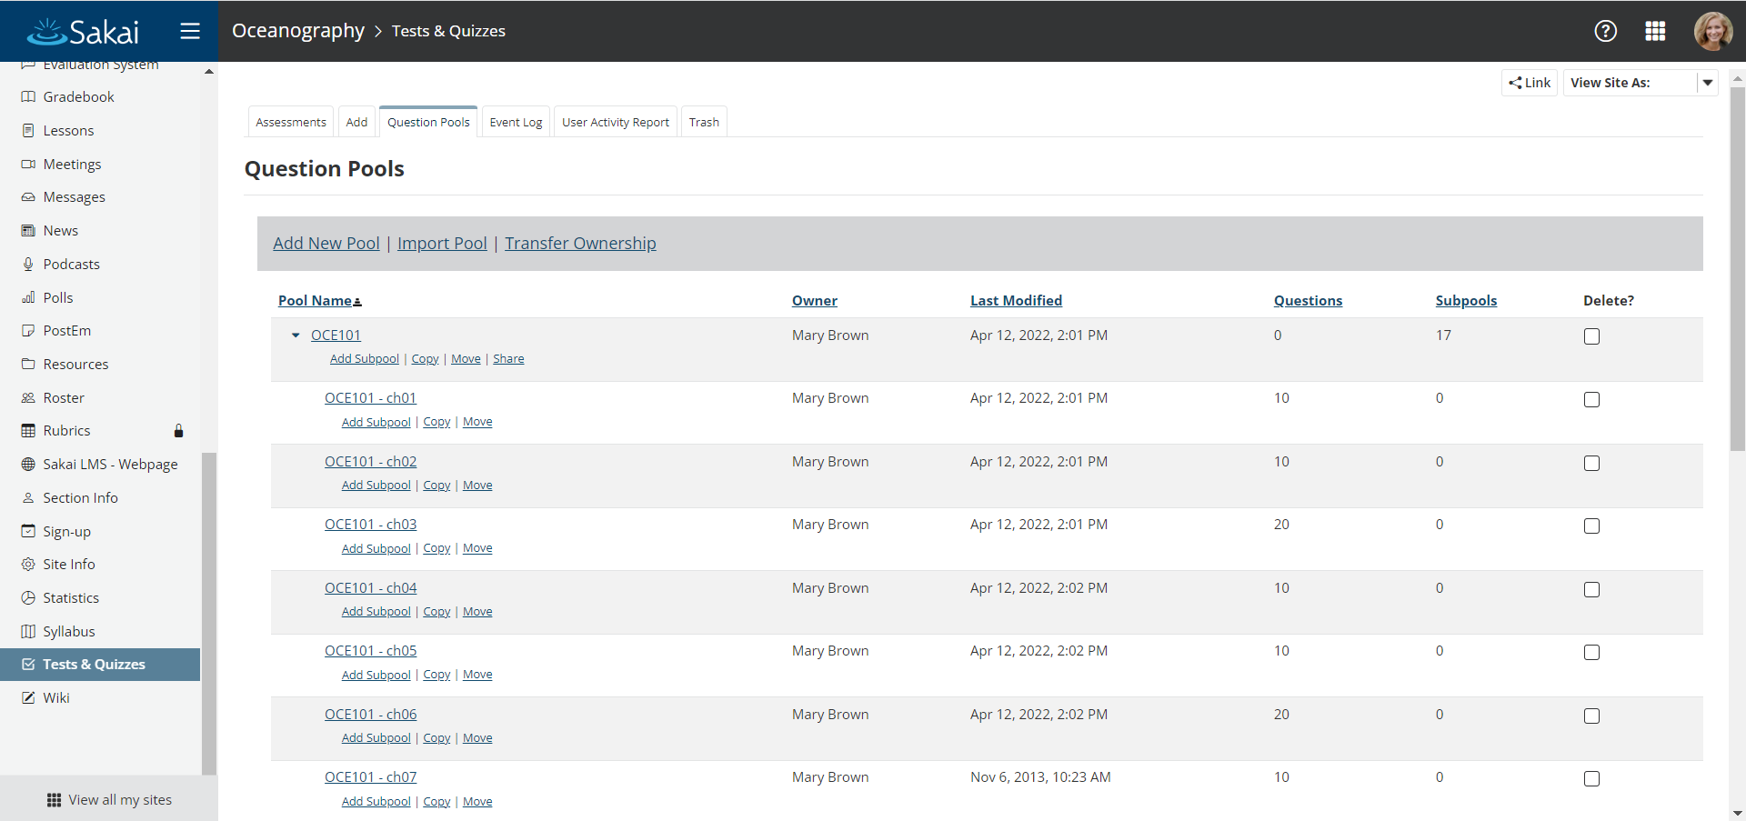
Tests & Quizzes - Question Pools

Slide 33
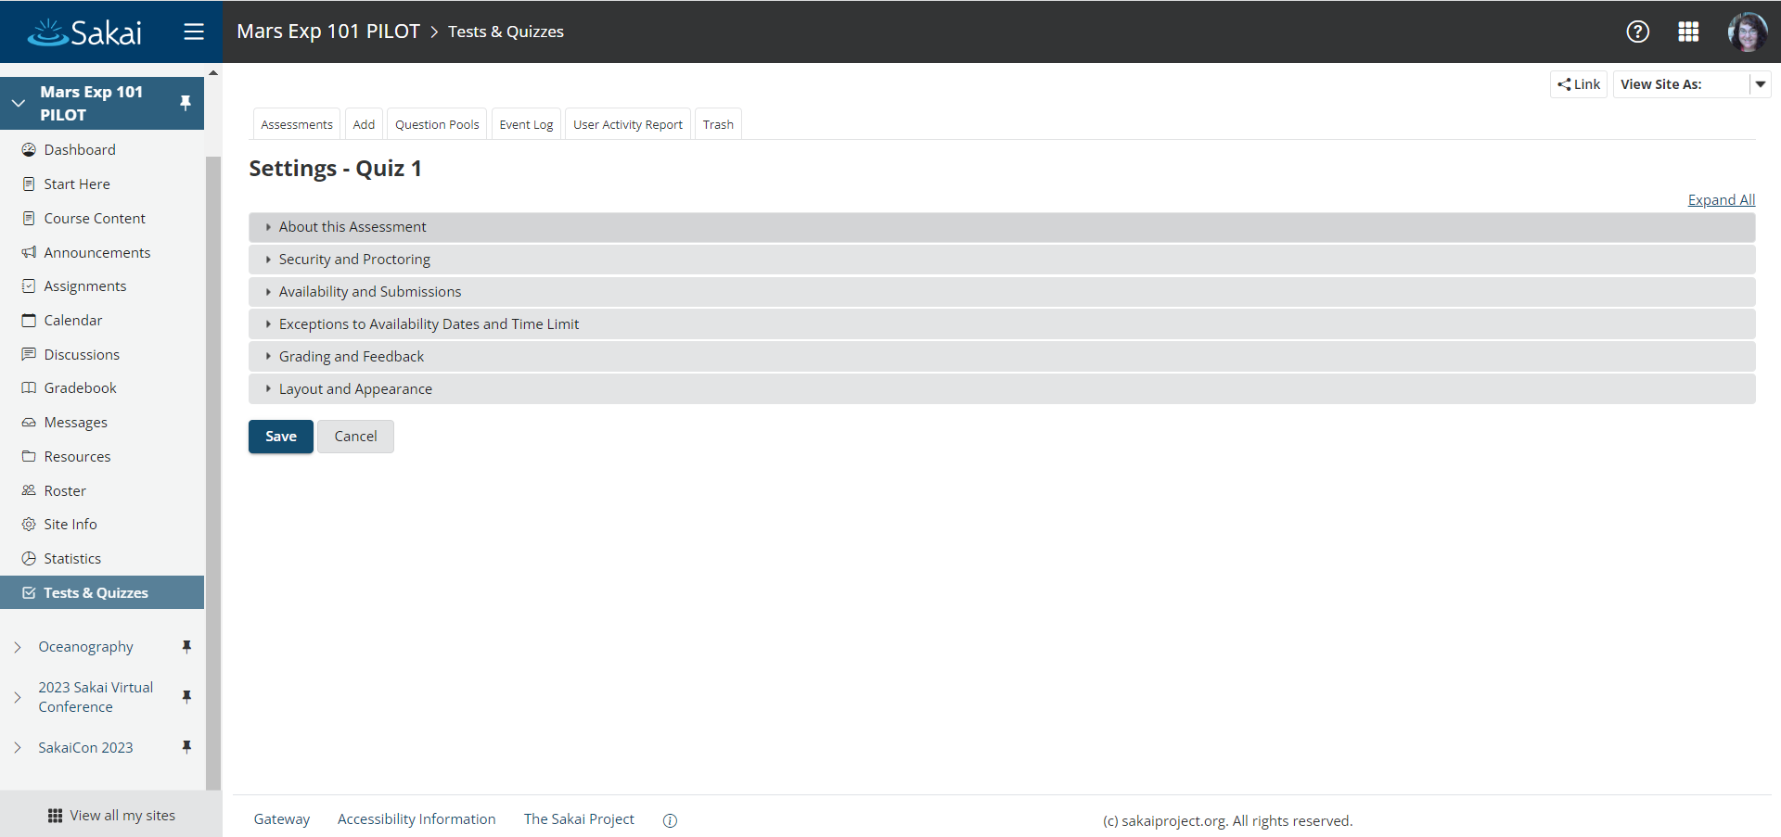
Tests & Quizzes - Settings

Slide 34
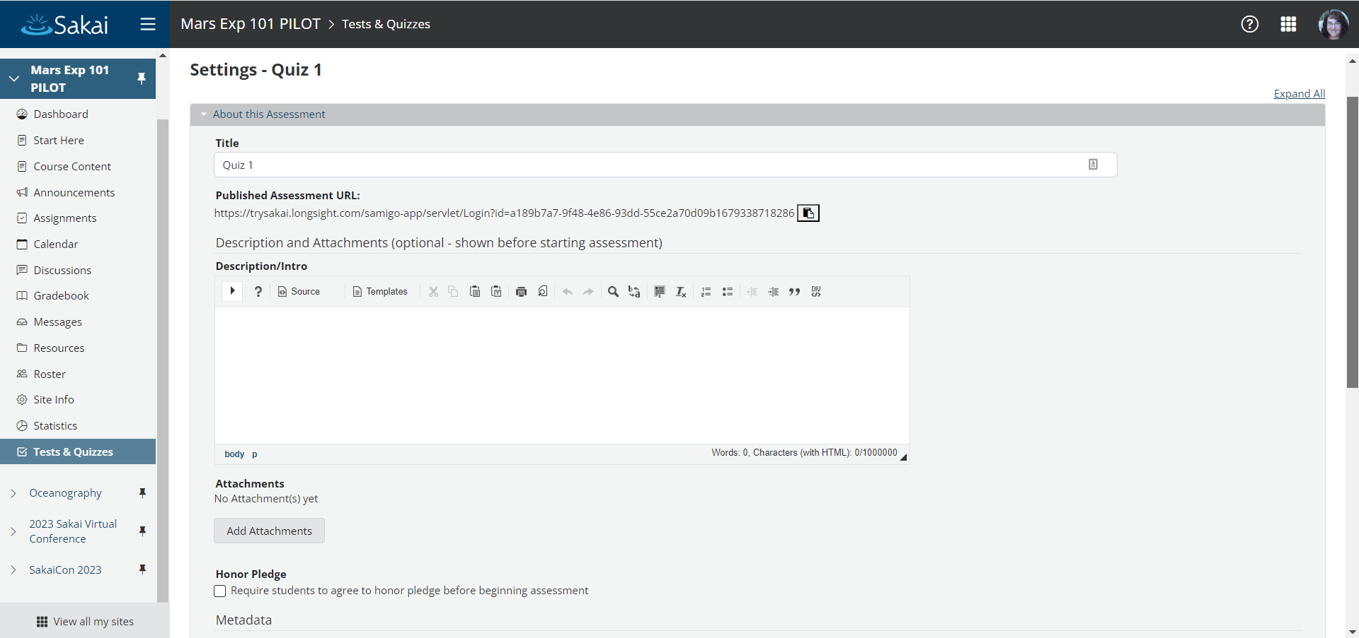
Tests & Quizzes - Settings > About this Assessment

Slide 35
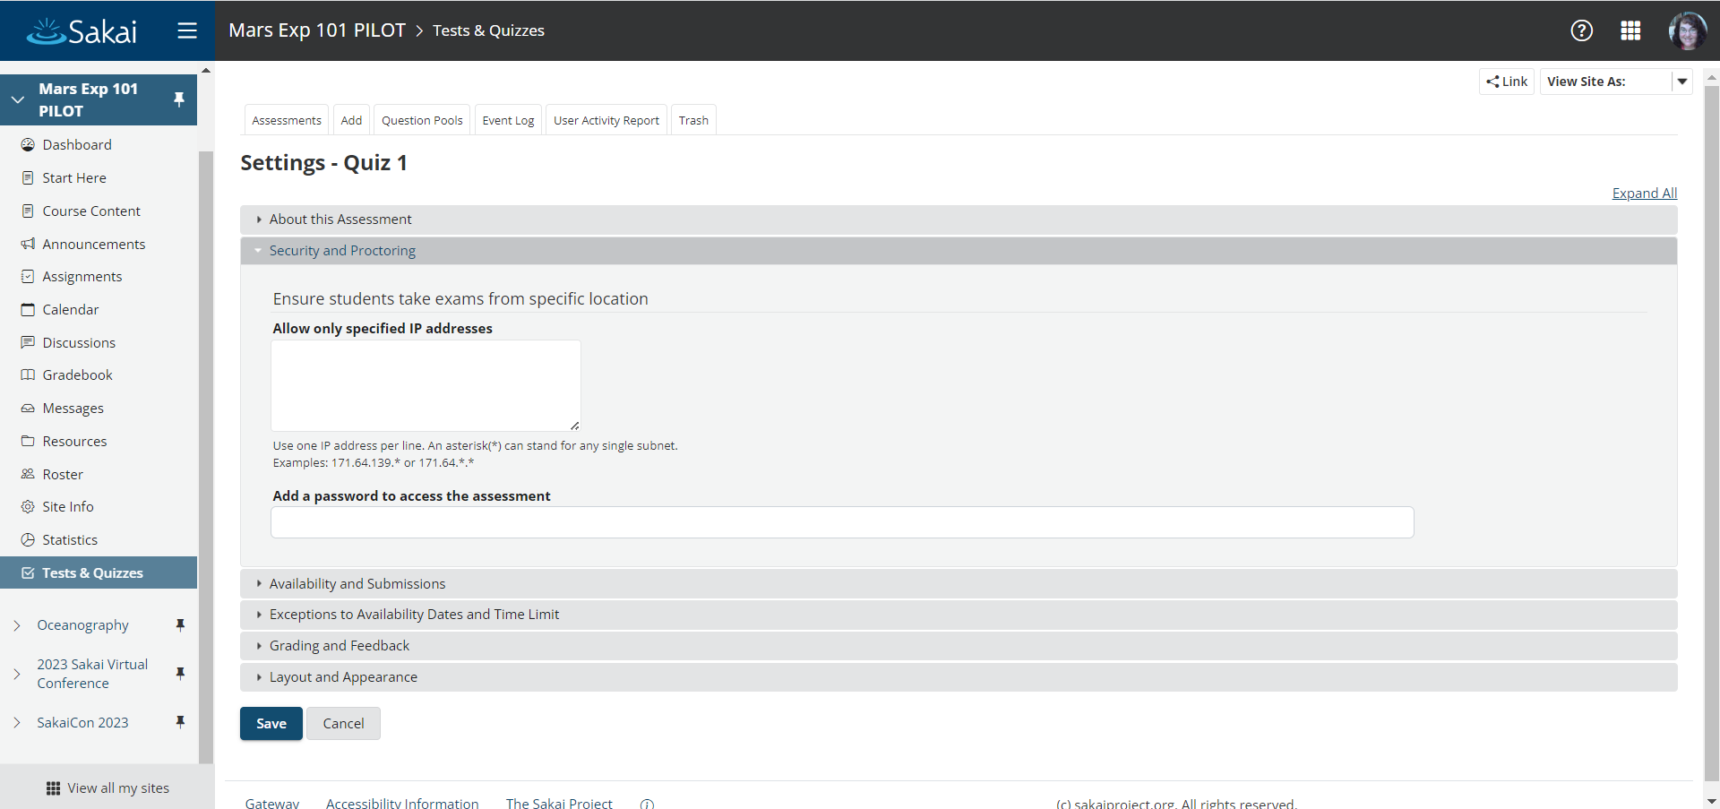
Tests & Quizzes - Settings > Security and Proctoring

Slide 36
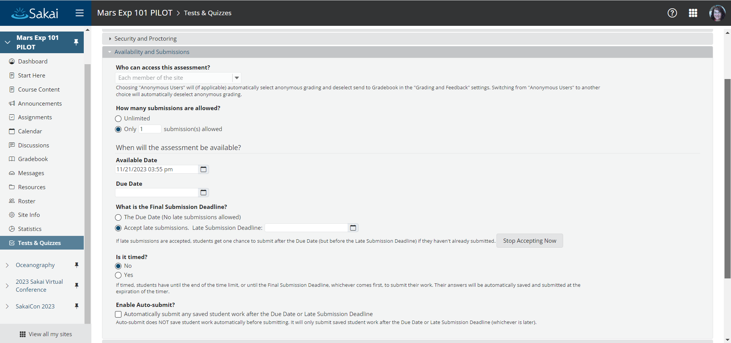
Tests & Quizzes - Settings > Availability and Submissions

Slide 37
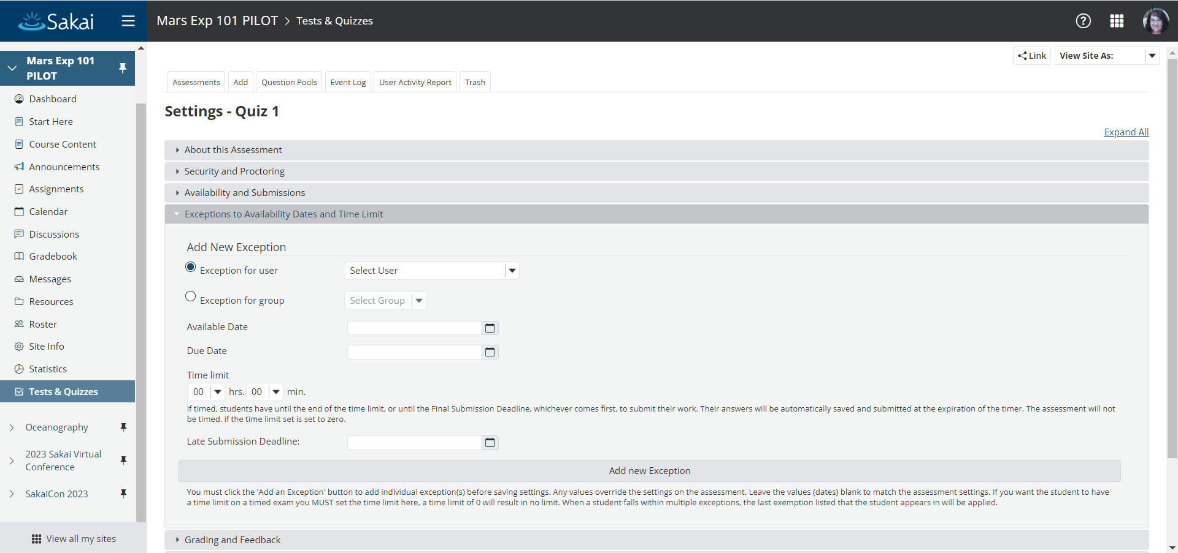
Tests & Quizzes - Settings > Exceptions

Slide 38
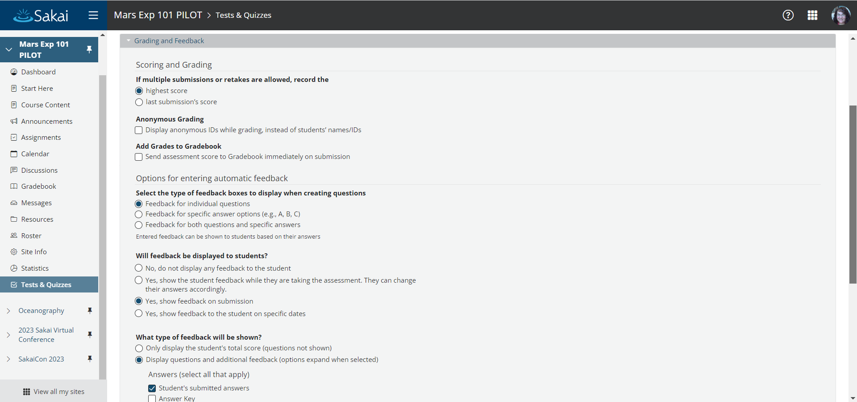
Tests & Quizzes - Settings > Grading and Feedback

Slide 39
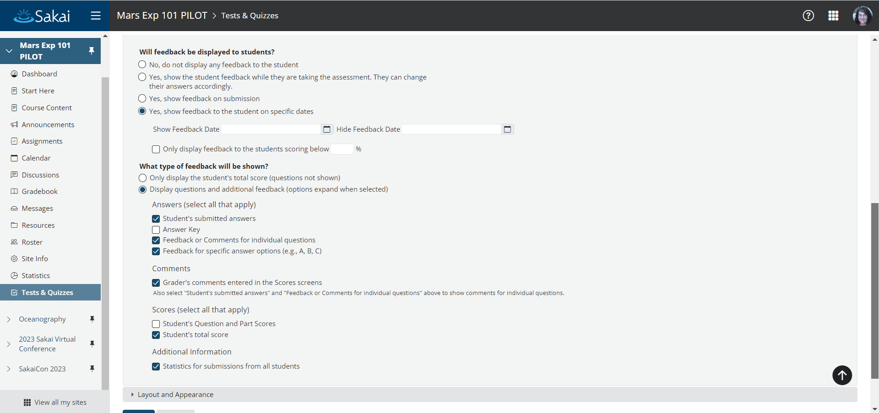
Tests & Quizzes - Settings > Grading and Feedback (cont.)

Slide 40
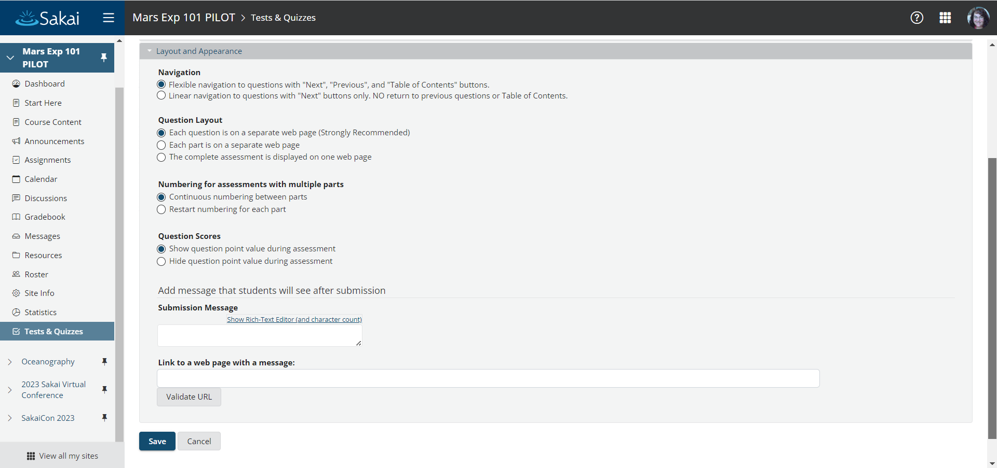
Tests & Quizzes - Settings > Layout and Appearance

Slide 41
Lessons
Flexible content authoring

Slide 42
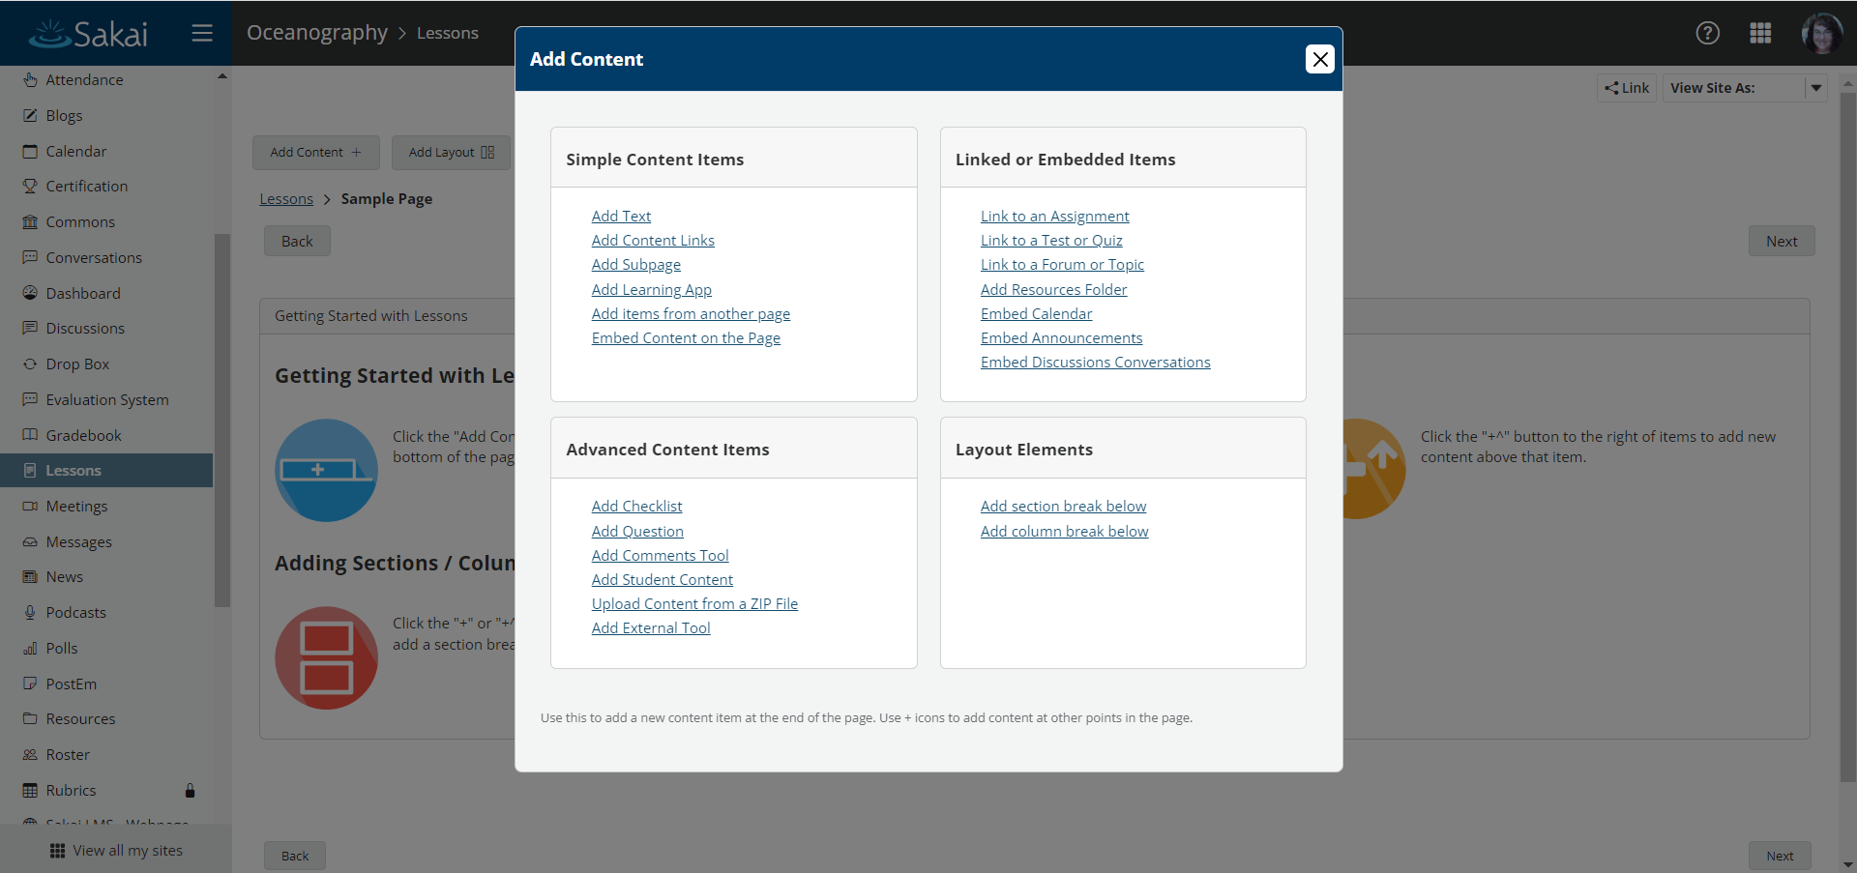
Lessons - Adding Content

Slide 43
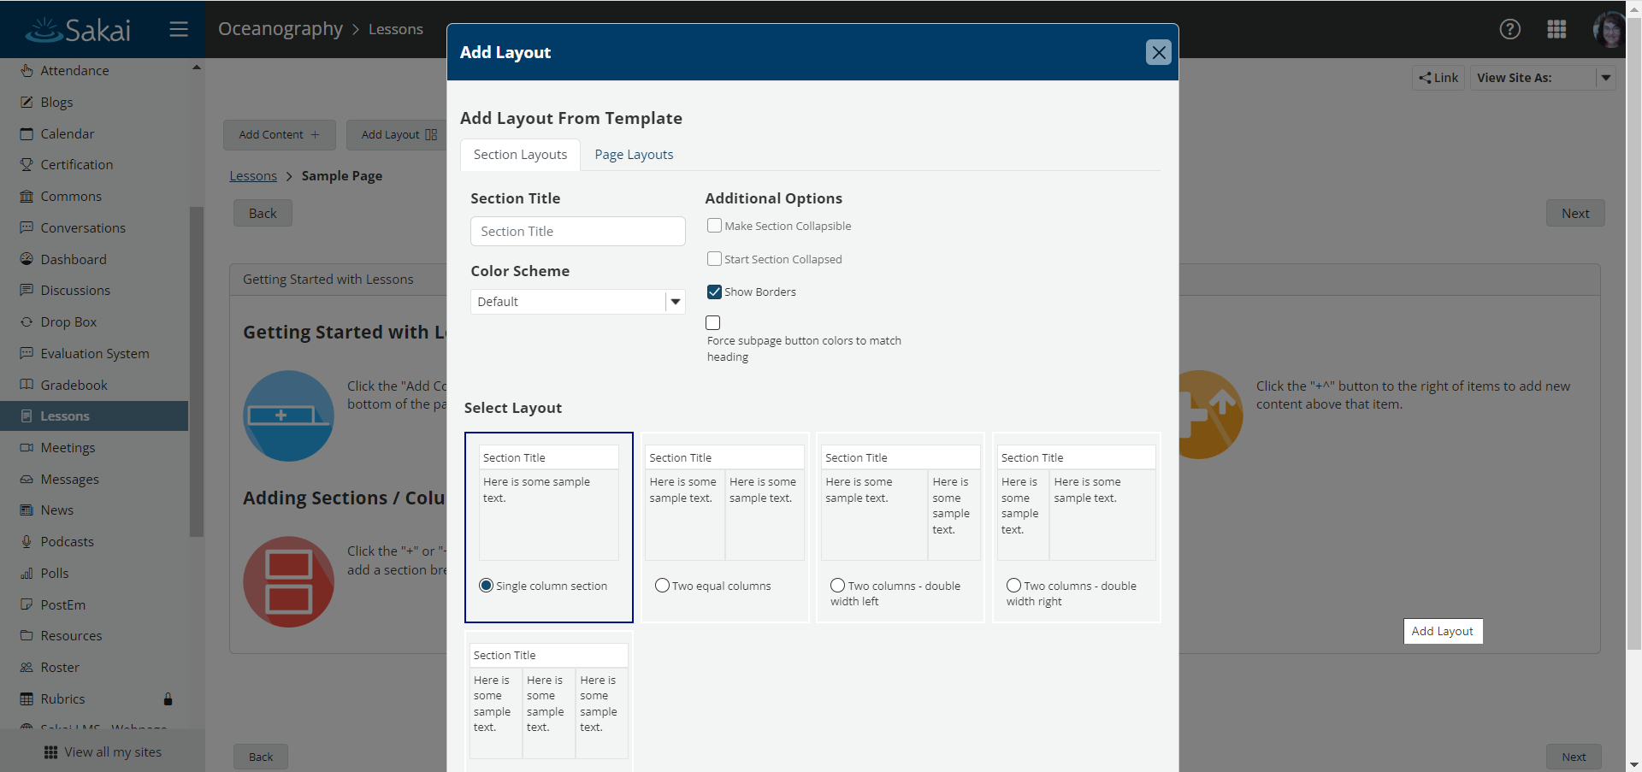
Lessons - Layouts and Templates

Slide 44
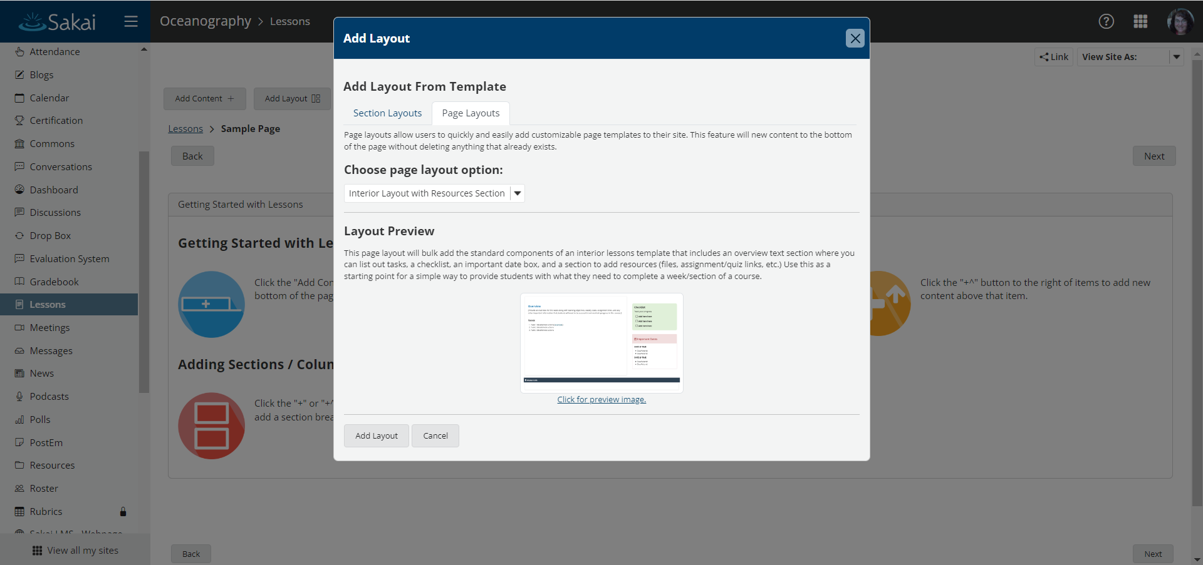
Lessons - Layouts and Templates (cont.)

Slide 45
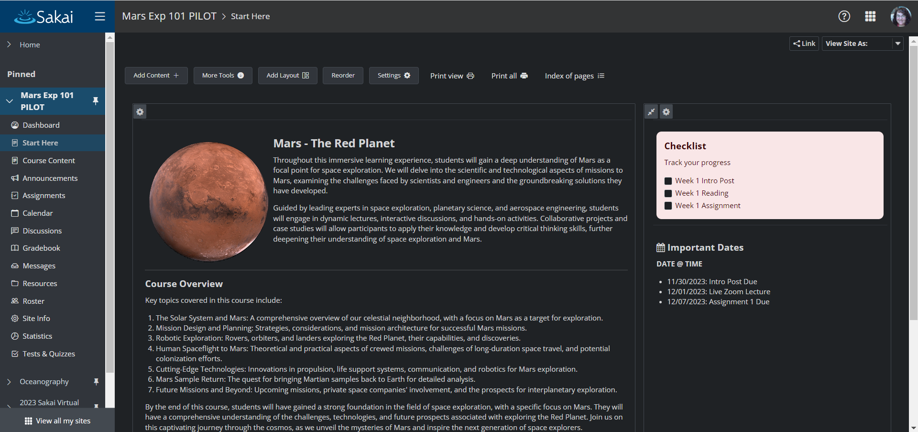
Lessons - Sample Course: Mars Exp 101

Slide 46
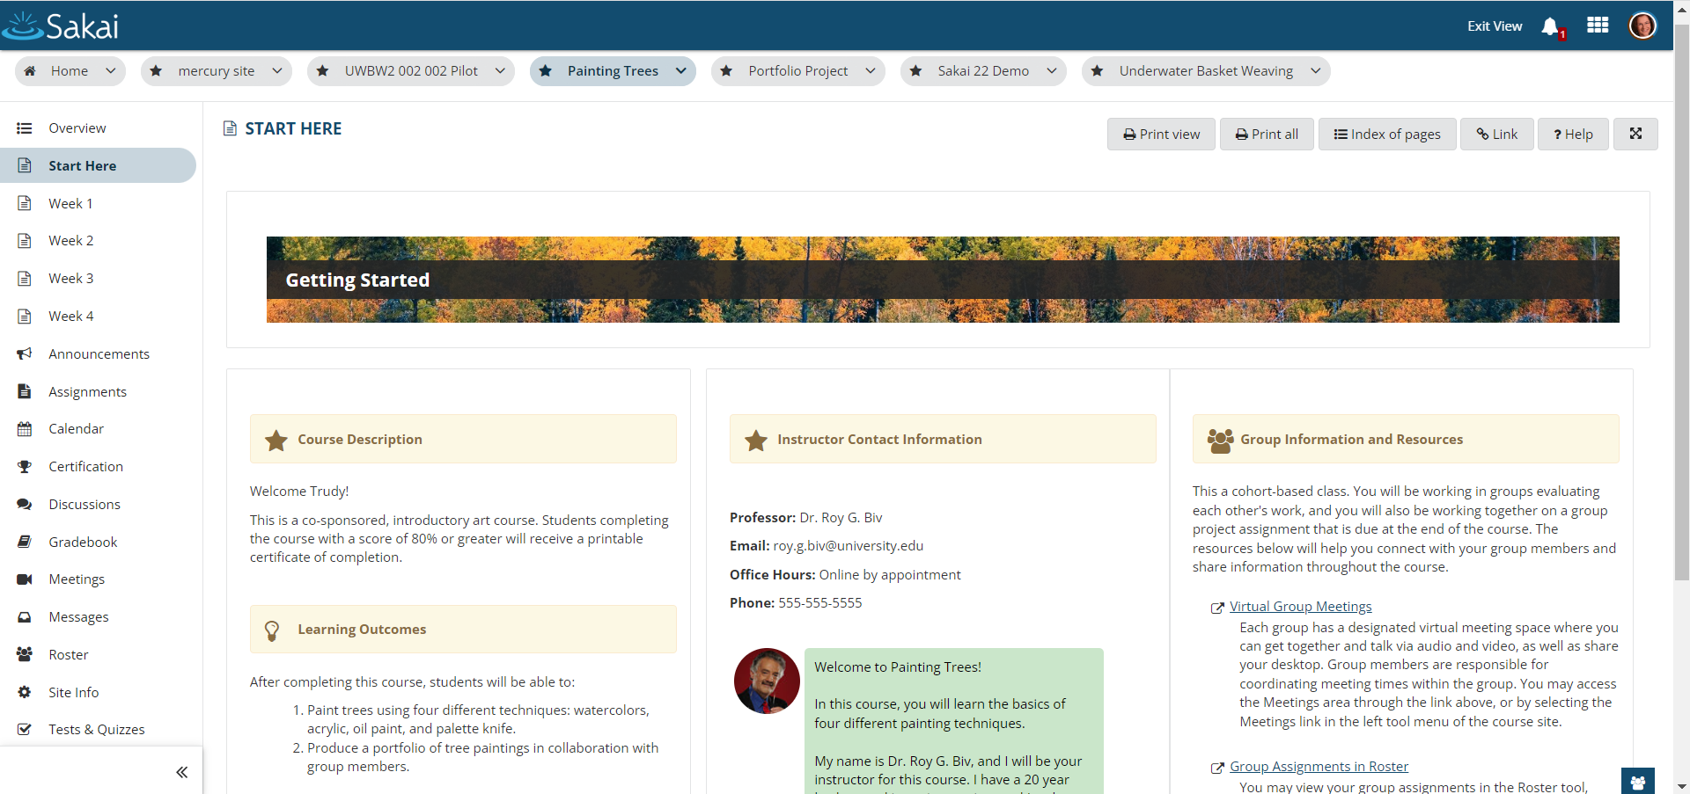
Lessons - Sample Course: Painting Trees

Slide 47
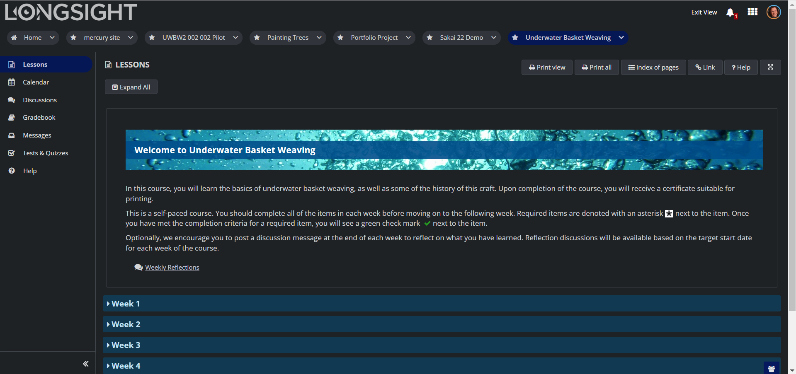
Lessons - Sample Course: Underwater Basket Weaving

Slide 48
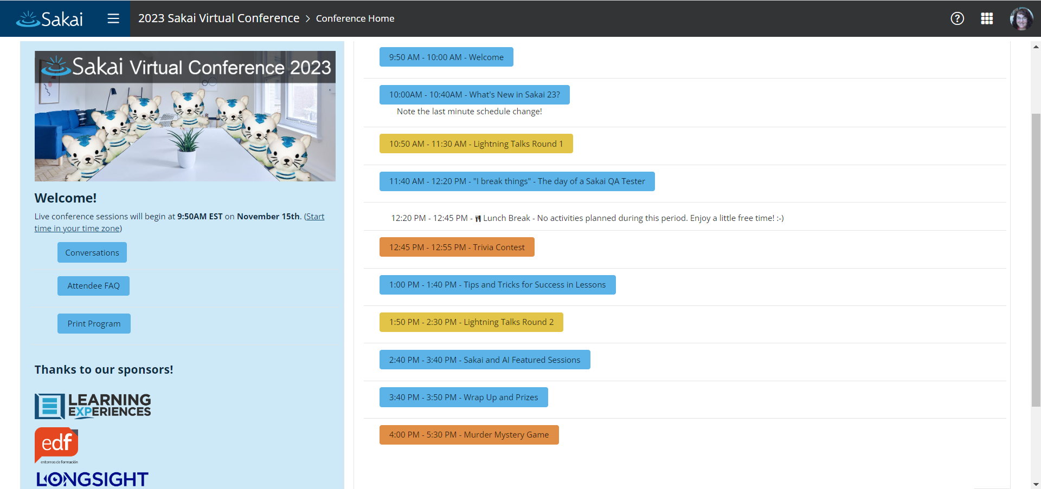
Lessons - Sample Site: 2023 Sakai Virtual Conference

Slide 49
SakaiPlus Beta: Timeline
SakaiPlus Beta
Beta customers 1Q24 2-6 schools 1-4 instructors at each school - Small / medium courses (30-100)
Weekly meetings as a "Team Plus" group for all Beta participants
Tuesdays at 2pm ET - December 2023 through June 2024
Planning for SakaiPlus in production 2Q24 / 3Q24
Beta will be 100% free

Slide 50
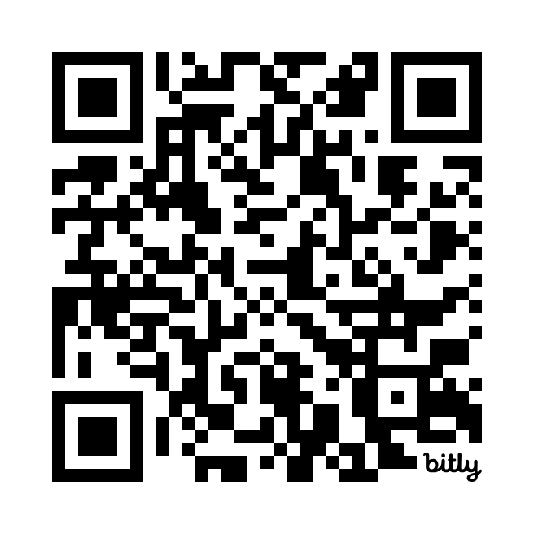
Let's Schedule a Meeting!
bit.ly/sakaiplus-beta
Present and Demonstrate Sakai Plus
Explore benefits to your organization
Instructional Designers
Innovative Faculty
Privacy Concerns
Install Sakai Plus in your sandbox or test
Yes, it is that easy!
Discuss pain points that Sakai Plus might address
Discuss pilot / production hosting options and costs

Slide 51

Questions? plus@sakailms.org
Dr. Charles Severance Sakai PMC Chair
Dr. Wilma Hodges Sakai Community Manager

Slide 52
SakaiPlus Production Hosting Options and Estimated Pricing*
Hosting Models | Server/Database | Cost (*, **, ***) | Supported By | Upgradable
Testing | Multi-tenant shared database | Free for < 200 student seats | LearnXP | No
Small | Multi-tenant with dedicated database | 200 - 1000 students @ $20 per user annually | LearnXP | Yes
Local Hosted AWS + Consulting from LearnXP | Your own locally supported server and dedicated database | Pay your own hosting + $1-2K / month consulting up to 3000 seats | LearnXP | Yes
Traditional Cloud Hosted + Support from Longsight | Choice of multi-tenant instance with shared or dedicated database, or individual instance with dedicated database | 1000 or more students starting at $20,000 annually (or approx. $20 per user) + one time implementation fee of 10-15% | Longsight | Yes
(*) These numbers are only shown as examples, for rough budgeting and to help understand the hosting choices that are possible for SakaiPlus. The pricing will be informed by Beta experiences and usage patterns of SakaiPlus versus SakaiLMS (Enterprise-wide).
(**) These numbers do not include the cost of setup which can be as low as zero, but can also be non-trivial and are often determined by institutional requirements.
(***) These are planning numbers only. We are happy to chat about your particular situation.
Note: Longsight and LearnXP will coordinate closely - customers can be handed back and forth seamlessly as they grow.

